Slide 1
Stock Market Analysis and Forecasting Using Deep Learning
Predicting Stock Prices of Amazon, IBM, and Microsoft using GRUs
Presented by: Utkarsh Singh
Registration No:- 23FE10ITE00345
Date: 24th April, 2025
Mentor :- Mrs. Rashmi Baratwal

Slide 2
Problem Statement
The stock market is highly volatile and influenced by numerous factors.
Traditional forecasting techniques struggle with capturing patterns in time-series data.
Need for a deep learning-based approach to improve accuracy in stock price predictions.
Objective: Use Gated Recurrent Units (GRUs) to analyze and forecast stock prices for Amazon, IBM, and Microsoft.

Slide 3
State of the Art Methods and Motivation
Traditional Methods:
Moving Averages, ARIMA, Regression Analysis.
Struggle to capture non-linear dependencies and long-term patterns.
Modern Deep Learning Approaches:
LSTMs and GRUs are capable of learning long-term dependencies.
Have shown significant improvements in time-series forecasting.
Motivation:
GRUs are computationally efficient compared to LSTMs.
Integrated into an interactive desktop app with dark mode, animation, and live model retraining features.

Slide 4
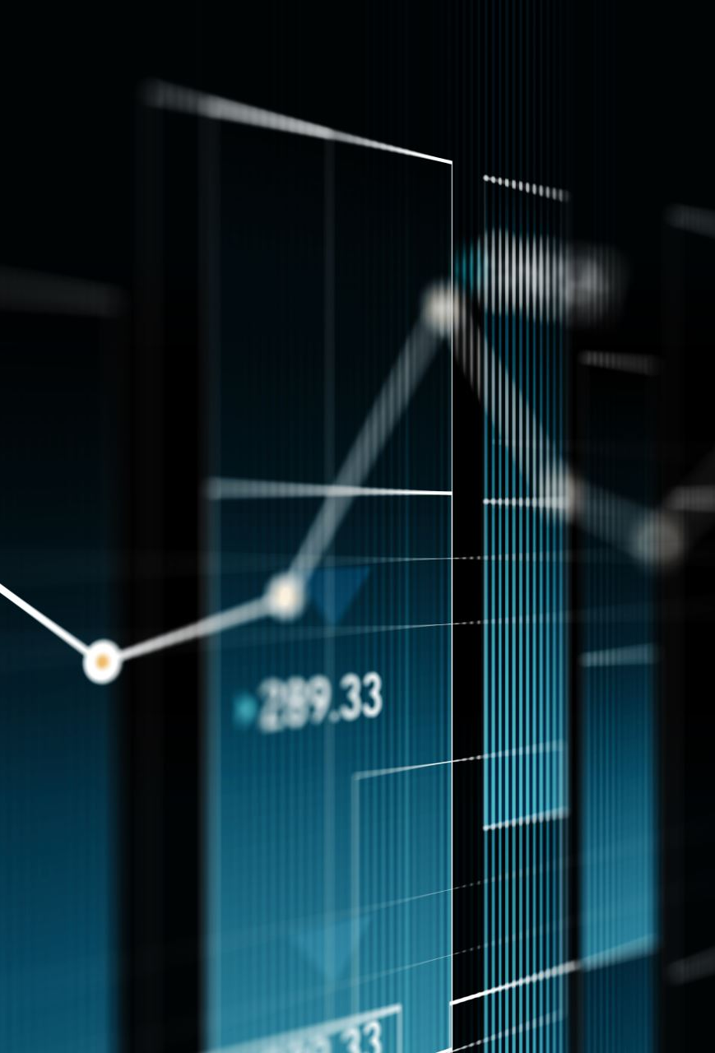
Methodology - Overall System Design and Flow
Data Collection: Fetch historical stock data from Yahoo Finance.
Data Preprocessing: Normalize stock prices and create sequential datasets.
Model Selection: GRU-based deep learning model.
Training: Train the model on stock price sequences.
Evaluation & Prediction: Validate model performance and forecast future prices.
Visualization: Display actual vs. predicted prices using Matplotlib.
Deployment: Flask-based API and web dashboard for real-time stock predictions.

Slide 5
Model Architecture
GRU-based neural network with the following configuration:
Input Layer: Stock price sequences.
Hidden Layers: 2 GRU layers (50 hidden units each).
Output Layer: Fully connected layer for stock price prediction.
Loss Function: Mean Squared Error (MSE)
Optimizer: Adam (Learning Rate = 0.001)

Slide 6
Results
Training Loss Graph: MSE loss over epochs.
Stock Prediction Graphs:
Amazon, IBM, Microsoft – Actual vs. Predicted prices.
Next-Day Price Prediction:
Displayed using Flask API & Web Dashboard.

Slide 7
Learnings
Importance of time-series data preprocessing.
Comparison between traditional methods and deep learning models.
Advantages of GRUs in stock price prediction.
Challenges faced (data noise, model tuning, integrating UI elements and animated plots).

Slide 8
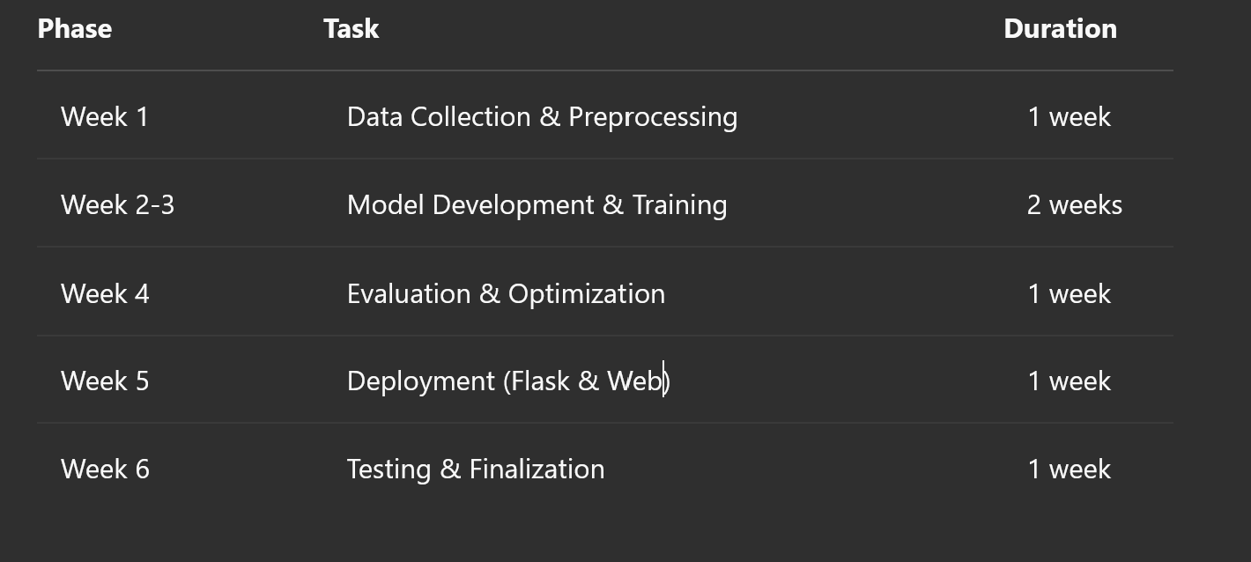
Project Timeline

Slide 9
Tech Stack Used
Programming Languages: Python.
Data Collection: Yahoo Finance API (yfinance).
Visualization: Matplotlib, Seaborn.
Backend: Flask API(Planned).
Frontend: Tkinter.
Deployment: AWS.
Deep Learning: PyTorch, NumPy, Pandas, Scikit-Learn.

Slide 10
References
Research papers on GRU-based stock forecasting.
Official documentation of PyTorch, Yahoo Finance API.
Tutorials and articles on deep learning time-series forecasting.
Relevant GitHub repositories.

